Slide 1
Learning language that matters
A pedagogical method to support low educated migrants in their social integration in Western countries
Rogier van ’t Rood, PhD & Christa Nieuwboer, PhD

Slide 2
Introductions
Rogier van ’t Rood, PhD
University researcher & lecturer
Education in an international context
Utrecht University
International consultant on education
Christa Nieuwboer, PhD
Researcher, supervisor
and Professor, Developments in parenting and parenting support
Fontys University of Applied Sciences
Twitter: @vantrood
www.ideal-participation.eu
info@ideal-participation.eu

Slide 3
Why we are here:
We talk a lot
about language…
But we should talk
about learning!
adult

Slide 4
Mission of this symposium
How do we support the most vulnerable groups of migrants in their efforts for social integration?
(Website LIAM, Guidelines COE)

Slide 5
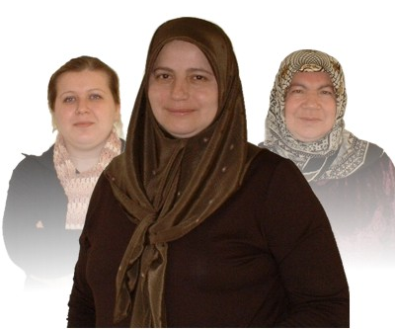
Most vulnerable groups:
Estimate of 30% of migrants are functional illiterate
“Course blocking”
(Beacco, 2014)

Slide 6
Social integration:
….is so much more than cognitive (language) learning!
It is also about change
Psychological mechanisms for change:
Feasibility; acceptability; role models; small steps
Pedagogical mechanisms for learning:
Teaching > facilitating learning about topics that matter
Preaching > Adding perspectives on topics that matter
Instructing > Learning language in context

Slide 7
Sadly:
Many illiterate participants have previously participated in language programmes without mentionable results, reinforcing the experience of
stagnation, failure, frustration and exclusion

Slide 8
How does IDEAL work:
IDEAL: Integrating Disadvantaged Ethnicities through Adult Learning
PARTICIPATORY APPROACH:
Taking THEIR mental framework
as the starting point of learning
IDEAL provides for a validated, effective and alternative learning approach for non-western immigrants, enhancing their inclusion in society
IDEAL goal: inclusion by increased participation and active citizenship

Slide 9
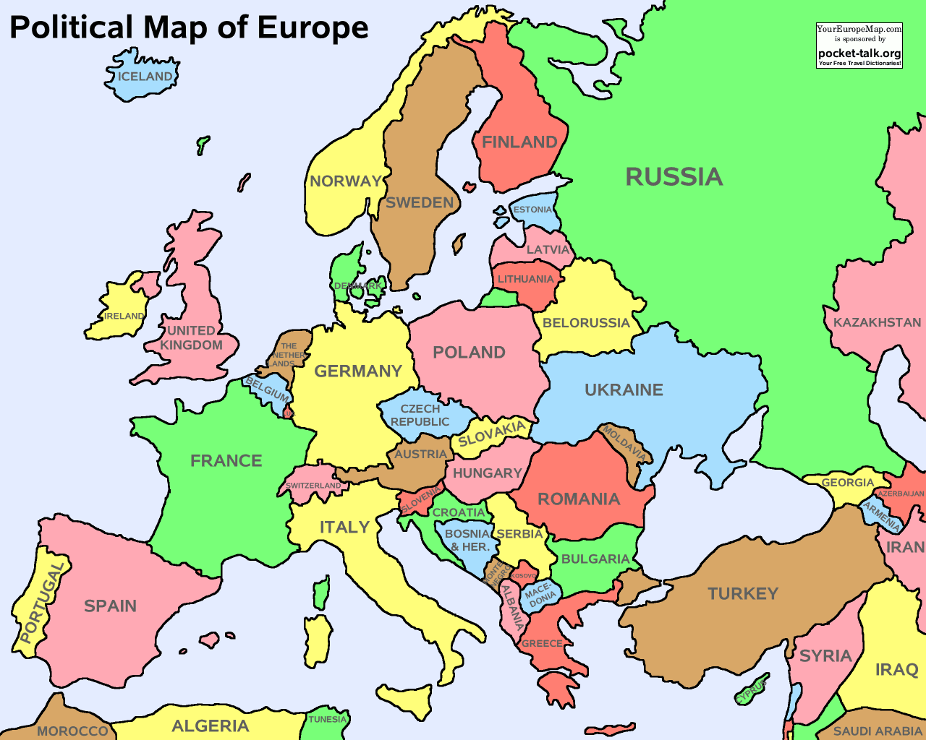
IDEAL: programme
2002 – now:
Leiden
Maastricht
The Hague
Malmö
Copenhagen
Skopje
.. Johannesburg

Slide 10
IDEAL: results
Integrating Disadvantaged Ethnicities through Adult Learning
Language acquisition (CEFR levels)
Baseline | Final | Score
A2 | A2+ | +0.5
A1+ | A2 | +0.5
A1 | A2 | +1
A2 | A2+ | +0.5
A1 | A2 | +1
A1 | A2+ | +1.5
A2 | A2+ | +0.5
A2 | A2+ | +0.5
A1+ | A2 | +0.5
A2 | A2+ | +0.5
A1 | A2 | +1
A0 | A1+ | +0.5
A0 | A1+ | +0.5
A0 | A1+ | +0.5
A0 | A1+ | +0.5
A1 | A2 | +1
Levels of participation
Baseline | Final | Score
2 | 2 | 0
1 | 2 | +1
1 | 2 | +1
0 | 2 | +2
0 | 2 | +2
1 | 2 | +1
1 | 2 | +1
1 | 2 | +1
1 | 2 | +1
1 | 2 | +1
0 | 1 | +1
0 | 1 | +1
0 | 1 | +1
0 | 1 | +1
0 | 1 | +1
0 | 1 | +1

Slide 11
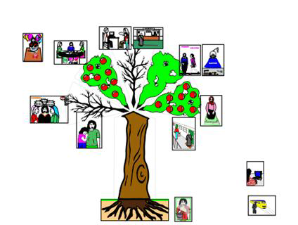
Method: what matters?
…to the learners!
Not to us…, but:

Slide 12
Method: learning process
share experiences
learn language
role play
peer support
practice
share & solve
participation & language acquisition

Slide 13
Compare to:
learn language
language acquisition

Slide 14
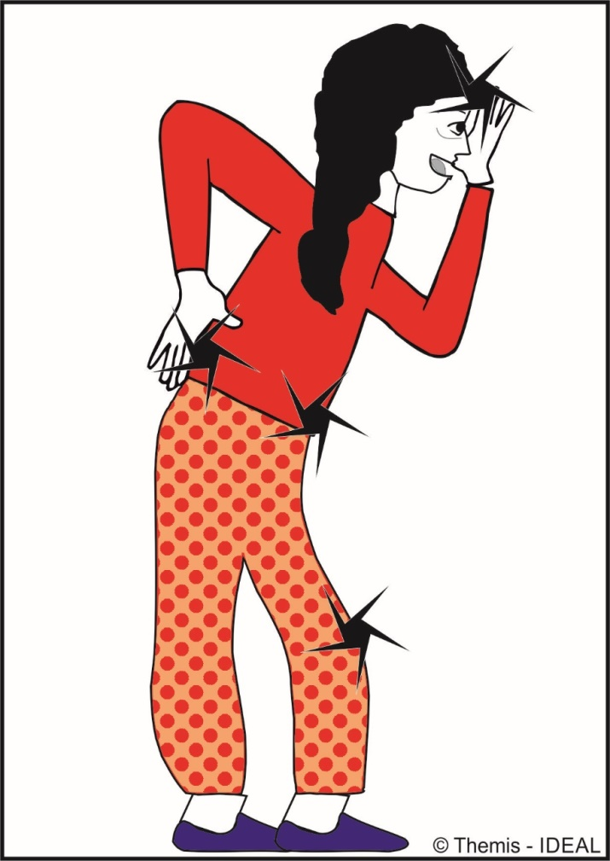
Example: Health
Experiences
Language
Role play
Peer support
Practice
Share & solve
Pains
Body parts
Playing ‘hospital’
Suggestions
Doctor’s visit
Discuss & improve

Slide 15
Example: Parenting
Experiences
Language
Role play
Peer support
Practice
Share & solve
Conflicts
Play
PLAY!
Ideas
Play
Have fun & learn

Slide 16
Example: Birthdays
Neglect
Compliments
Celebrate!
Feeling good
Transfer
Self esteem

Slide 17
Main characteristics:
Standard language course | IDEAL
Fixed mindset on goals (tests) | Learning process and growth mindset
Instructional approach | Social-constructivist approach
Teacher in L2 | Role model facilitator
Teacher centered | Emphatically learner centered
Heterogeneous groups | Homogeneous groups (e.g., women)
Static curriculum | Semi-structured curriculum
L2 approach | Mother tongue dual approach
Cognitive approach | Multi-sensory appeal
Written materials | Creative didactic tools
External motivation | Challenging and ‘lean forward’

Slide 18
Obstacles for migrant learning
We force migrants to find a course and pay for their own education
We force learning with external motivation, tests, fines, expulsion
We leave the provision of courses to commercial parties, who are not interested in these ‘difficult target groups’, who do not pass exams

Slide 19
Think:
We raise and teach our children in order to become critical contributing citizens. Children’s education costs 12-16 years and € 15-20.000 pp.
Migrants should pay for their own education…! (Dutch policy)

Slide 20
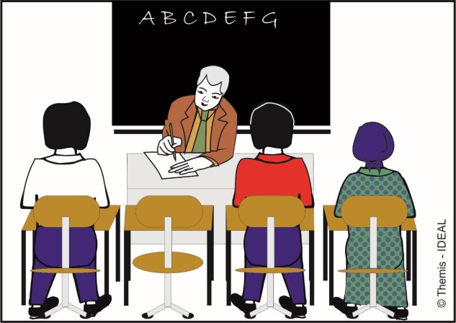
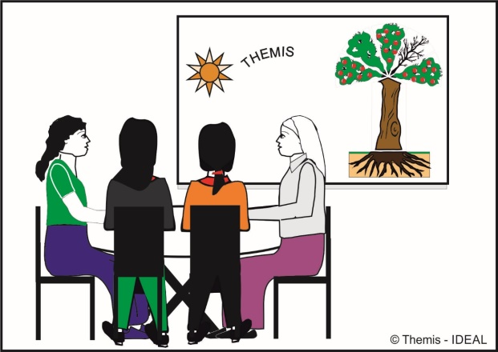
Our statement:
It’s normal to teach and help our children to participate in society.
Let’s consider: it’s normal to teach and help migrants to participate in society.
We should invest in participatory pedagogical methods!
IDEAL

Slide 21
Publications (open access)
IDEAL Handbook (2013):
This handbook describes in detail the relevance, background and methodology of IDEAL, the implementation modalities, characteristics of the target group, and opportunities and limitations of the approach.
Hyperlink to full text
International Journal of Intercultural Relations (2016):
Nieuwboer, C.C. & Rood, R.A. van ’t (2016). Learning language that matters, A pedagogical method to support migrant mothers without formal education experience in their social integration in Western countries, International Journal of Intercultural Relations, 51, 29-40
Hyperlink to full text

Slide 22
Supported by
2010-2013 Programme:
Certification as of 2012, by:

Slide 23
Contact
Rogier van ’t Rood, PhD
University researcher & lecturer
Education in an international context
Utrecht University
International consultant on education
Christa Nieuwboer, PhD
Researcher, supervisor
and Professor, Developments in parenting and parenting support
Fontys University of Applied Sciences
Twitter: @vantrood
www.ideal-participation.eu
info@ideal-participation.eu

Slide 24
AIMS of the programme:
IDEAL aims to:
Stimulate active participation in a western society
Increase self esteem, self confidence, and communication skills
Increase the command of the target language
Increase parenting skills in a gender balanced and democratic context
Create awareness about causes of problems at family and neighbourhood levels (also affecting health)
Stimulate attitudinal change for effectively solving those problems
Stimulate participants to internalise other views and visions.

Slide 25
Difficulties migrants face:
These migrants face the following difficulties:
Lack of skills to learn in a formal setting, no learning strategies
Very limited knowledge and understanding of western societies
Lack of skills as how to adjust traditional ways of child upbringing to gender balanced and democratic societies
None or too limited command of the language of their host country
Low self-esteem and self confidence, and limited communication skills
Often social problems in the family and the neighbourhood, also causing psychosomatic illnesses.

